Slide 1
Data Mining for Business Intelligence
Chapter 11: Neural Nets
Kichun Lee, Ph.D.
Department of Industrial Engineering
Hanyang University, Seoul, Korea

Slide 2
Basic Idea
Combine input information in a complex & flexible neural net “model”
Model “coefficients” are continually tweaked in an iterative process
The network’s interim performance in classification and prediction informs successive tweaks

Slide 3
Network Structure
Multiple layers
Input layer (raw observations)
Hidden layers
Output layer
Nodes
Weights (like coefficients, subject to iterative adjustment)
Bias values (also like coefficients, but not subject to iterative adjustment)

Slide 4
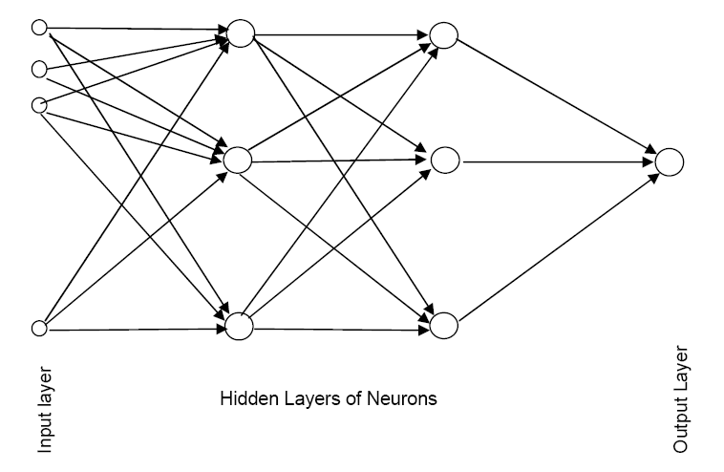
Schematic Diagram

Slide 5
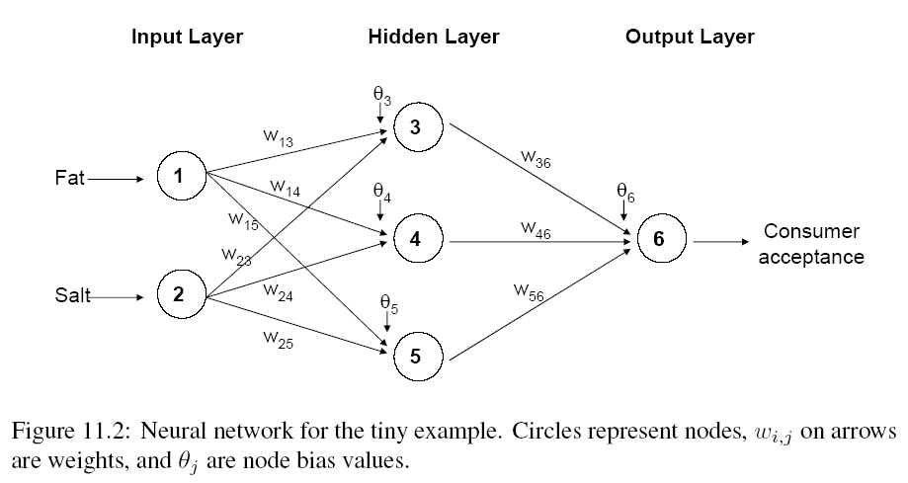
Example – Using fat & salt content to predict consumer acceptance of cheese

Slide 6
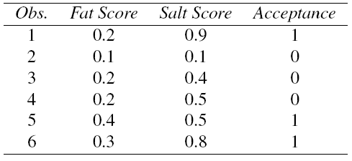
Example - Data

Slide 7
Moving Through the Network

Slide 8
The Input Layer
For input layer, input = output
E.g., for record #1:
Fat input = output = 0.2
Salt input = output = 0.9
Output of input layer = input into hidden layer

Slide 9
The Hidden Layer
In this example, hidden layer has 3 nodes
Each node receives as input the output of all input nodes
Output of each hidden node is a function of the weighted sum of inputs

Slide 10
The Weights
The weights θ (theta) and w are typically initialized to random values in the range -0.05 to +0.05
Equivalent to a model with random prediction (in other words, no predictive value)
These initial weights are used in the first round of training

Slide 11
Output of Node 3, if g is a Logistic Function

Slide 12
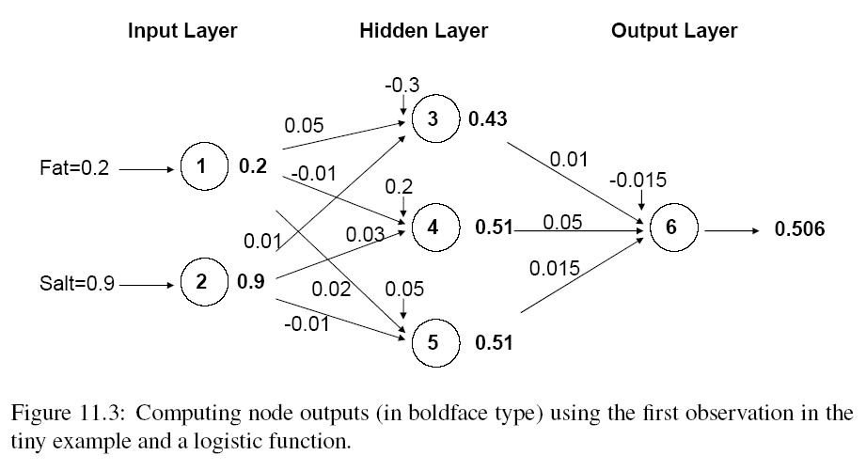
Initial Pass of the Network

Slide 13
Output Layer
The output of the last hidden layer becomes input for the output layer
Uses same function as above, i.e. a function g of the weighted average

Slide 14
The output node

Slide 15
Mapping the output to a classification
Output = 0.506
If cutoff for a “1” is 0.5, then we classify as “1”

Slide 16
Relation to Linear Regression
A net with a single output node and no hidden layers, where g is the identity function, takes the same form as a linear regression model

Slide 17
Training the Model

Slide 18
Preprocessing Steps
Scale variables to 0-1
Categorical variables
If equidistant categories, map to equidistant interval points in 0-1 range
Otherwise, create dummy variables
Transform (e.g., log) skewed variables

Slide 19
Initial Pass Through Network
Goal: Find weights that yield best predictions
The process we described above is repeated for all records
At each record, compare prediction to actual
Difference is the error for the output node
Error is propagated back and distributed to all the hidden nodes and used to update their weights

Slide 20
Back Propagation (“back-prop”)
Output from output node k:
Error associated with that node:
Note: this is like ordinary error, multiplied by a correction factor

Slide 21
Error is Used to Update Weights
l = constant between 0 and 1, reflects the “learning rate” or “weight decay parameter”

Slide 22
Case Updating
Weights are updated after each record is run through the network
Completion of all records through the network is one epoch (also called sweep or iteration)
After one epoch is completed, return to first record and repeat the process

Slide 23
Batch Updating
All records in the training set are fed to the network before updating takes place
In this case, the error used for updating is the sum of all errors from all records

Slide 24
Why It Works
Big errors lead to big changes in weights
Small errors leave weights relatively unchanged
Over thousands of updates, a given weight keeps changing until the error associated with that weight is negligible, at which point weights change little

Slide 25
Common Criteria to Stop the Updating
When weights change very little from one iteration to the next
When the misclassification rate reaches a required threshold
When a limit on runs is reached

Slide 26
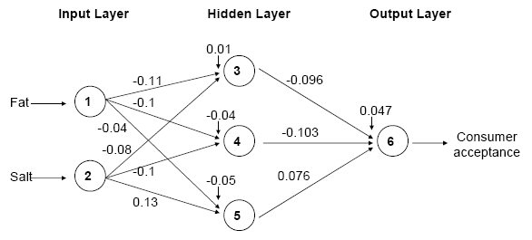
Fat/Salt Example: Final Weights

Slide 27
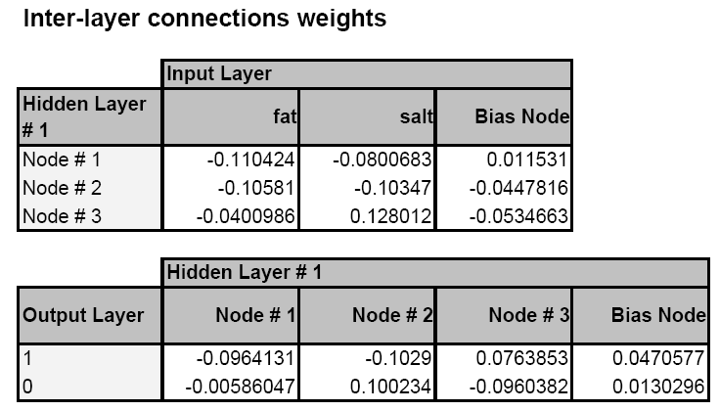
XLMiner Output: Final Weights
Note: XLMiner uses two output nodes (P[1] and P[0]); diagrams show just one output node (P[1])

Slide 28
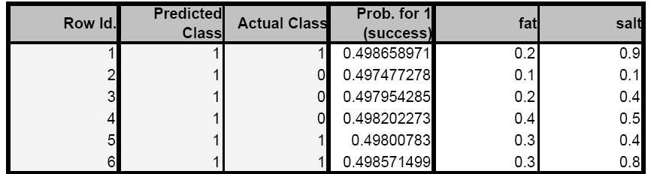
XLMiner: Final Classifications

Slide 29
Avoiding Overfitting
With sufficient iterations, neural net can easily overfit the data
To avoid overfitting:
Track error in validation data
Limit iterations
Limit complexity of network

Slide 30
User Inputs

Slide 31
Specify Network Architecture
Number of hidden layers
Most popular – one hidden layer
Number of nodes in hidden layer(s)
More nodes capture complexity, but increase chances of overfit
Number of output nodes
For classification, one node per class (in binary case can also use one)
For numerical prediction use one

Slide 32
Network Architecture, cont.
“Learning Rate” (l)
Low values “downweight” the new information from errors at each iteration
This slows learning, but reduces tendency to overfit to local structure
“Momentum”
High values keep weights changing in same direction as previous iteration
Likewise, this helps avoid overfitting to local structure, but also slows learning

Slide 33
Automation
Some software automates the optimal selection of input parameters
XLMiner automates # of hidden layers and number of nodes

Slide 34
Advantages
Good predictive ability
Can capture complex relationships
No need to specify a model

Slide 35
Disadvantages
Considered a “black box” prediction machine, with no insight into relationships between predictors and outcome
No variable-selection mechanism, so you have to exercise care in selecting variables
Heavy computational requirements if there are many variables (additional variables dramatically increase the number of weights to calculate)

Slide 36
Summary
Neural networks can be used for classification and prediction
Can capture a very flexible/complicated relationship between the outcome and a set of predictors
The network “learns” and updates its model iteratively as more data are fed into it
Major danger: overfitting
Requires large amounts of data
Good predictive performance, yet “black box” in nature

